Slide 1
An online celebrity named Liziqi
演讲人：邱磊磊
学 号：202050228
May 8th ,2021

Slide 2
1. Who is Li Ziqi?
2. What did she do?
CONTENTS
3. Why she became popular?
4. Look forward to more people
like Li Ziqi .

Slide 3
PART ONE
Who is Li Ziqi?

Slide 4
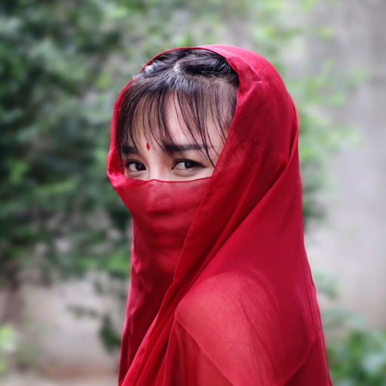
Who is Li Ziqi?
李子柒 本名（李佳佳）
Born in Mianyang, Sichuan in 1990
Chinese food short video creator
Well-known food video blogger on Weibo
Known as "Oriental Food Life Home"
she has a large number of domestic and foreign fans
Notes:
李子柒是跟着爷爷奶奶在四川农村长大的，爷爷去世后，奶奶就成了李子柒在这世上的至亲之人。
Li Ziqi grew up in rural Sichuan with his grandparents. After the death of his grandfather, his grandmother became Li Ziqi's closest relatives in this world.
由于家境清贫，14岁她就辍学出去打工了，2012年因为奶奶的一场重病，她决定回家照顾奶奶。
Due to her poor family, she dropped out of school at the age of 14 and went to work.
In 2012, due to a serious illness of her grandma, she decided to go home to take care of her grandma.

Slide 5
PART TWO
What did she do?

Slide 6
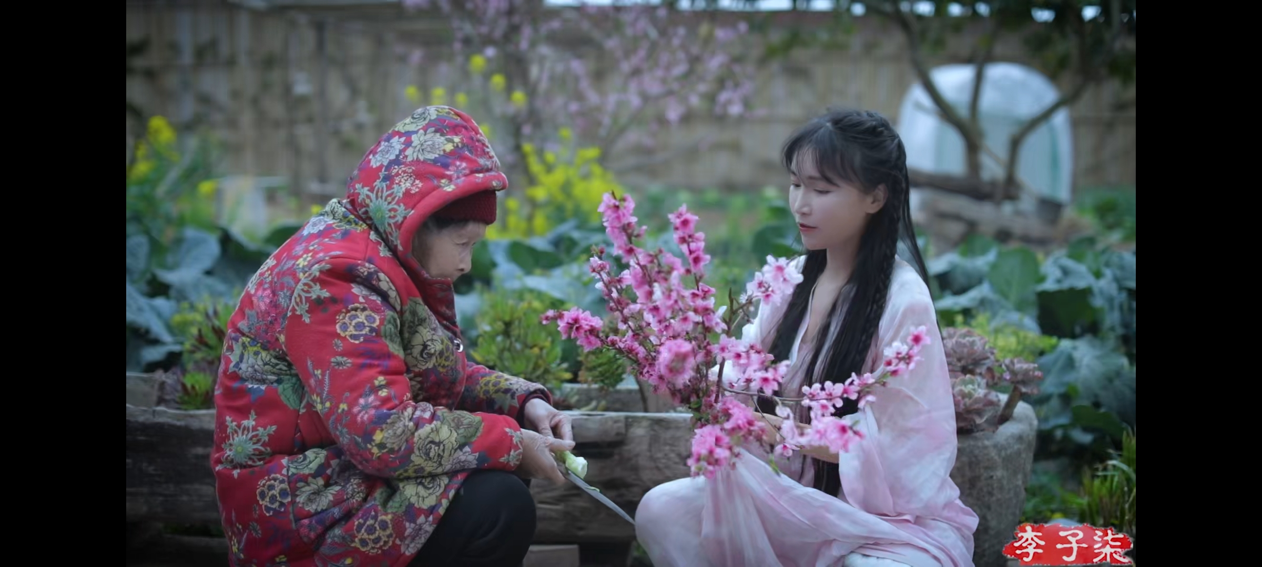
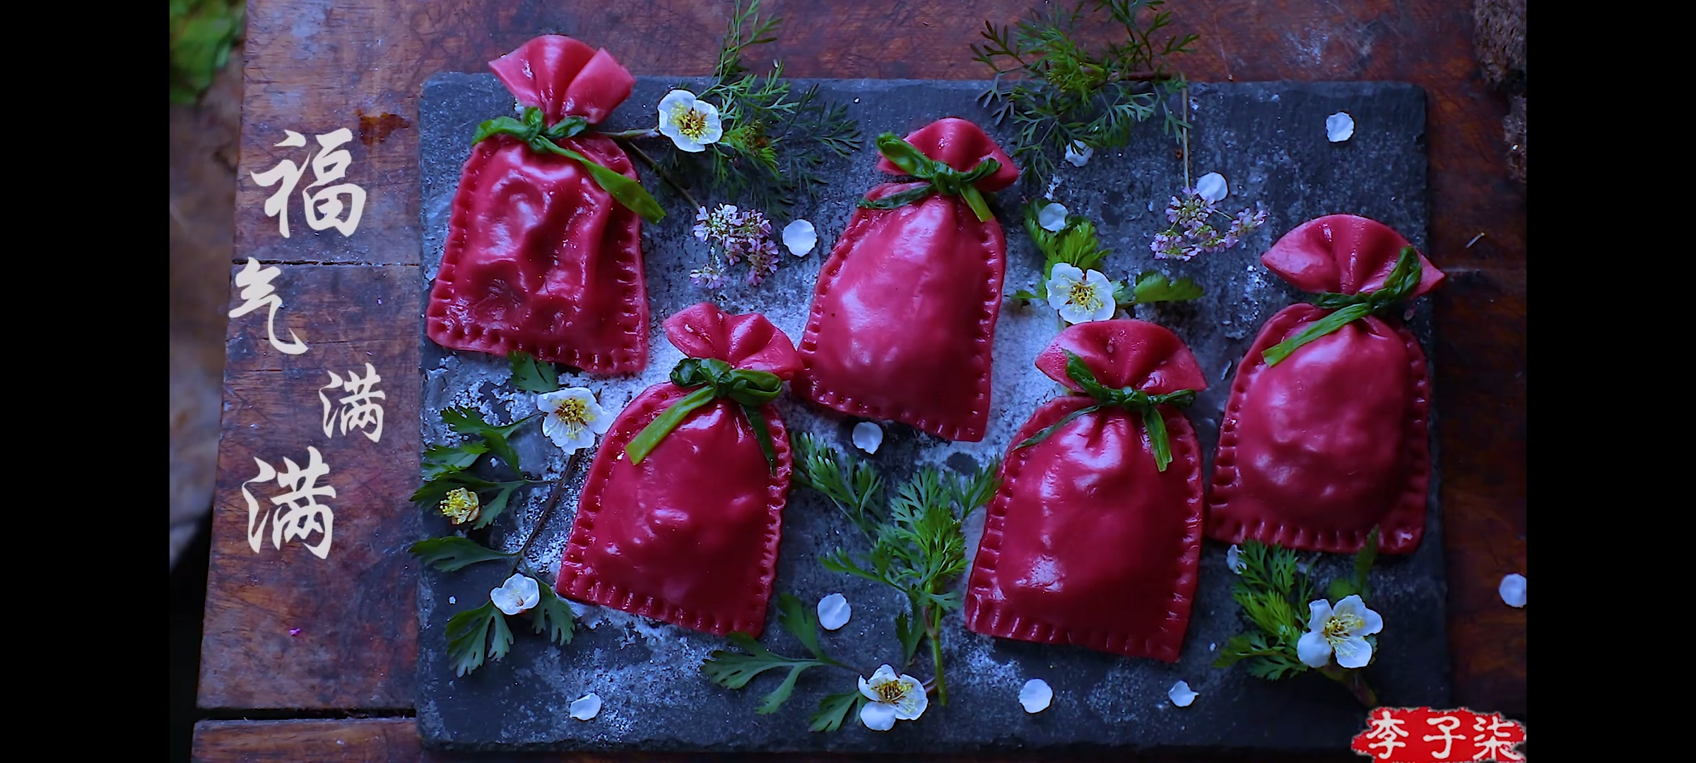
What did she do?
her and her grandmother
delicious food
Notes:
作为一个美食博主，她拍摄自己制作美食的整个过程，并且记录自己在农村的日常生活。
As a food blogger, she filmed the whole process of making her own food and documented her daily life in the countryside.
2015年，李子柒开始自拍自导美食短视频。在拍摄内容的选择上，与奶奶生活在一起的李子柒选择了最熟悉的农村生活。
In 2015, Li Ziqi started making short food videos. In the selection of shooting content, Li Ziqi, who lives with her grandmother, chose the most familiar rural life.

Slide 7
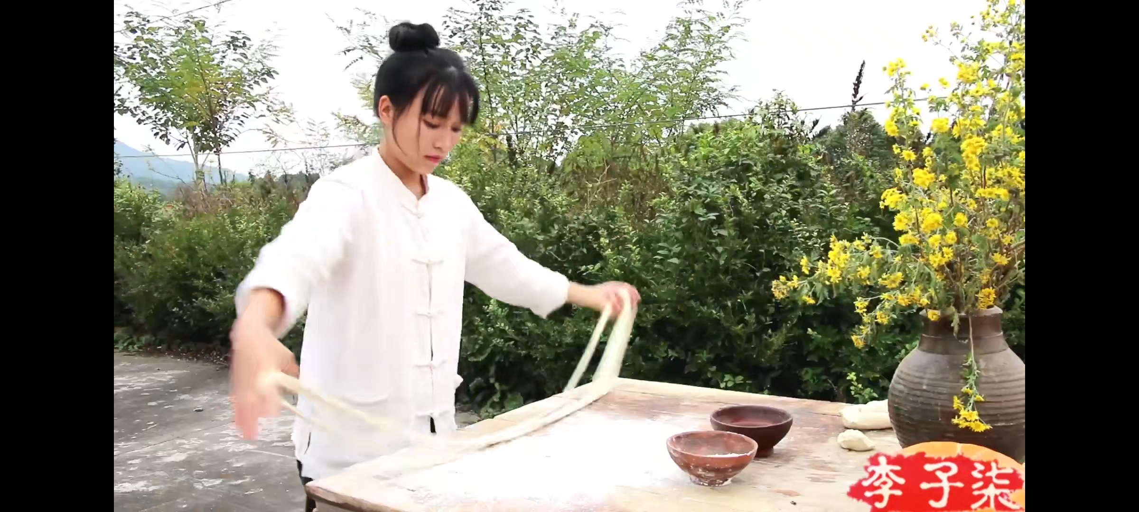
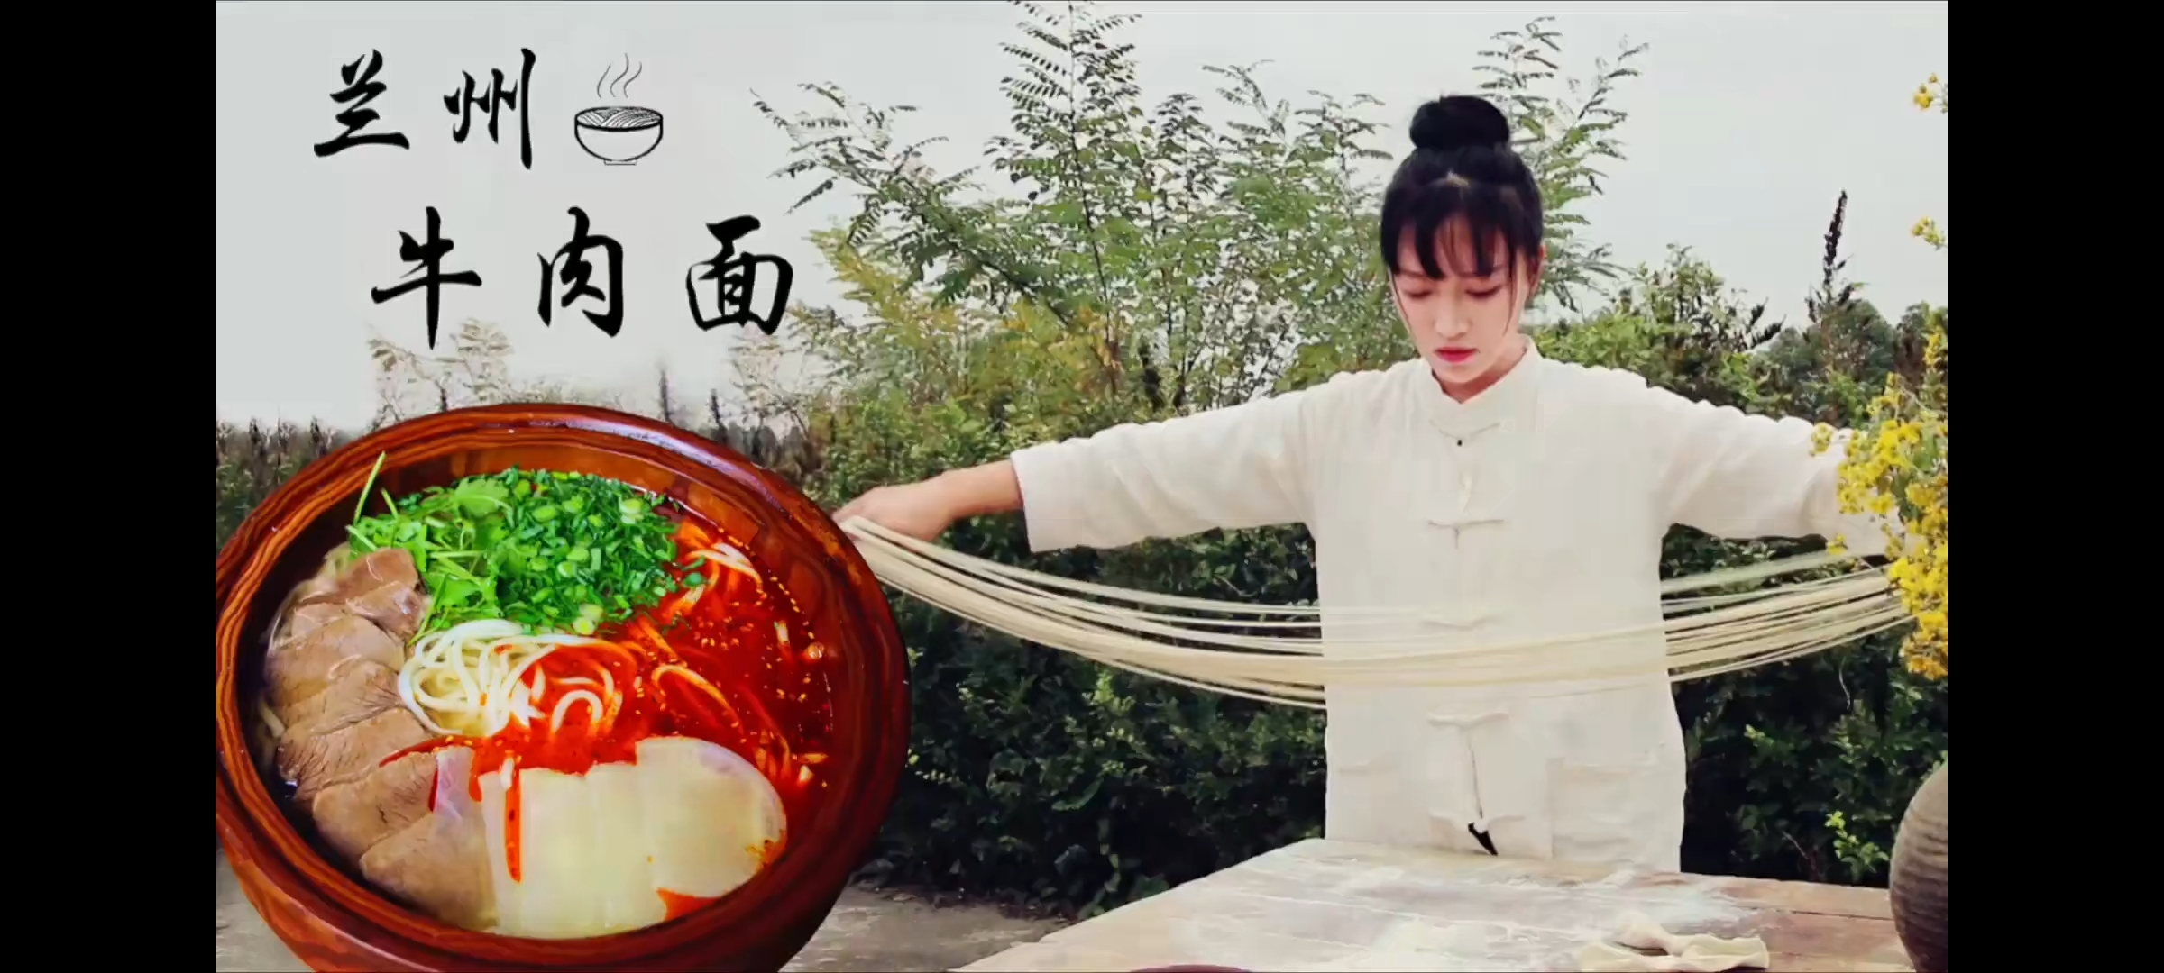
What did she do?
Li Zixuan's famous work is "Homemade Lanzhou Ramen"
Notes:
Lanzhou Beef Hand-pulled Noodles are one ofChina's top ten noodles as well as the "living fossils" of China’s noodlesculture.
兰州牛肉拉面，是“中国十大面条”之一，是中国面食文化的活化石。
2016年，凭借短视频《兰州拉面》获得广泛关注。
In 2016, she gained wide attention with her short video "Lanzhou Ramen".
为了拍摄制作拉面的过程，她专门花了2个月去甘肃拜师学习如何制作拉面。在制作的过程中，她失败了很多次。然而，她并没有放弃而是不断的努力，最终她成功掌握了制作拉面的整个过程。
In order to film the process of making ramen, she spent two months in Gansu Province to learn how to make ramen. During the production process, she failed many times. However, she didn't give up and kept trying, and eventually she managed to master the whole process of making ramen.

Slide 8
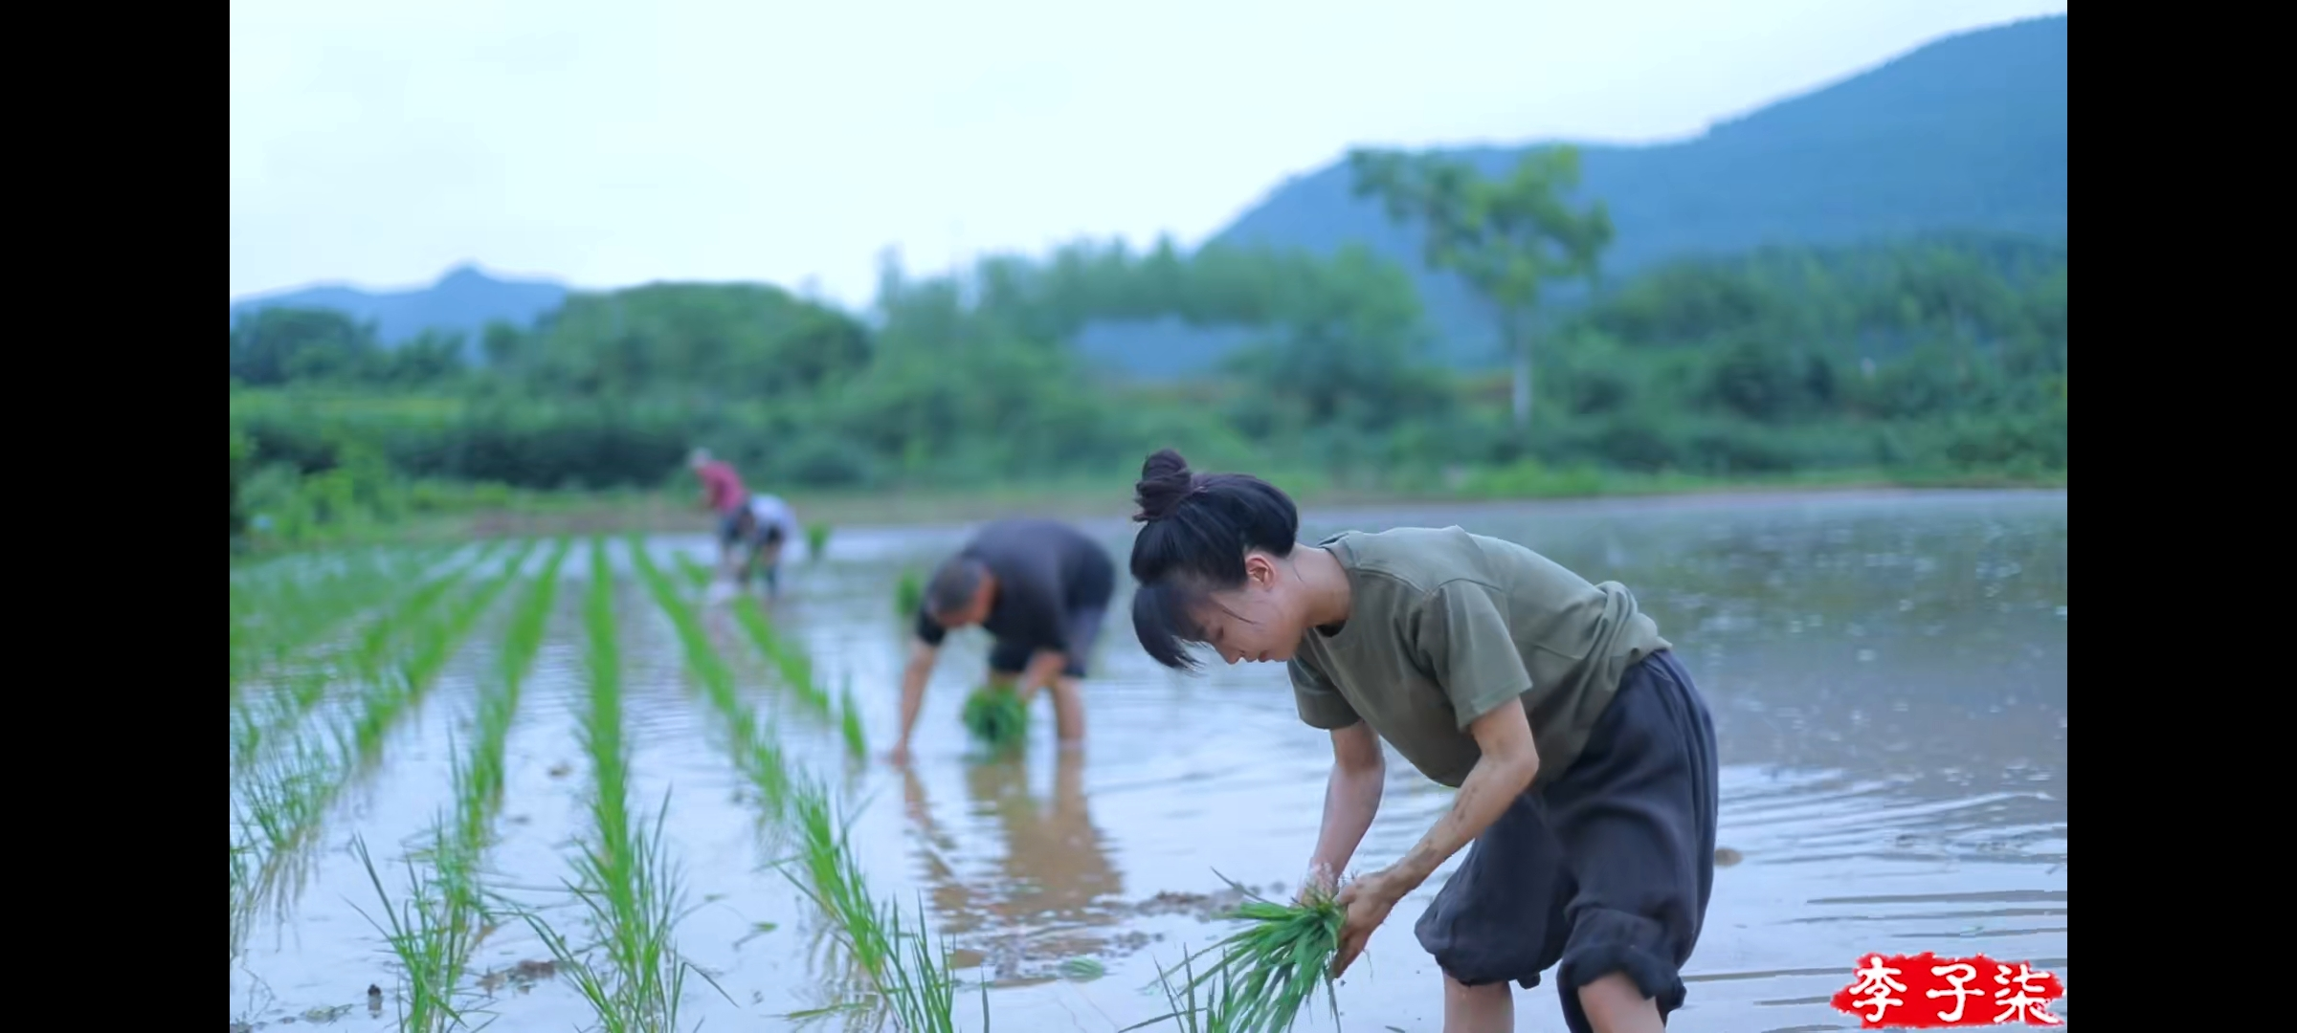
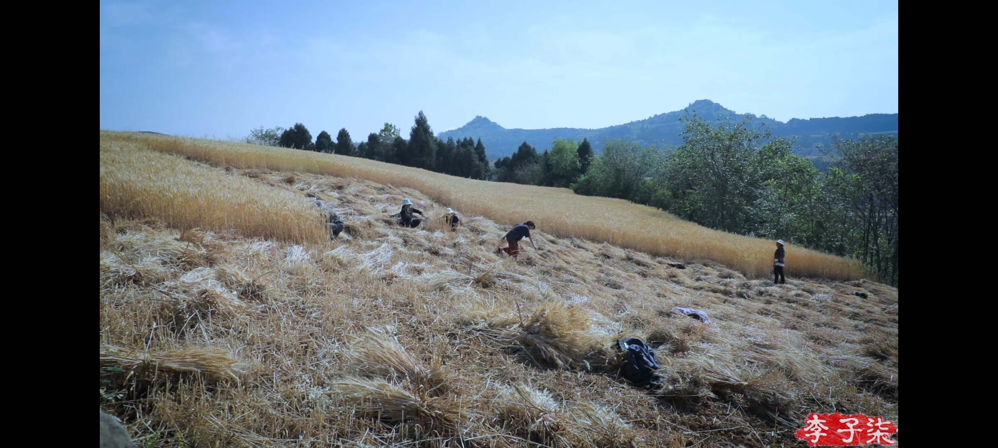
What did she do?
She is doing farm work
Notes:
作为一个视频博主，她的视频主题来源于中国人真实、朴素的传统生活，以中华民族引以为傲的美食文化为主线，围绕衣食住行四个方面展开。
As a vlogger, the theme of her videos comes from the real and simple traditional life of the Chinese people, taking the food culture that the Chinese nation is proud of as the main line, and focusing on the four aspects of clothing, food, housing and transportation.
李子柒在视频里向我们展示了四川大山里纯天然的美食以及朴素的生活方式。
In the video, Li Ziqi shows us the natural food and simple lifestyle in the mountains of Sichuan.
如左图她在插秧，右图收割小麦
The picture on the left shows that she is planting rice
The picture on the right shows that she is harvesting wheat

Slide 9
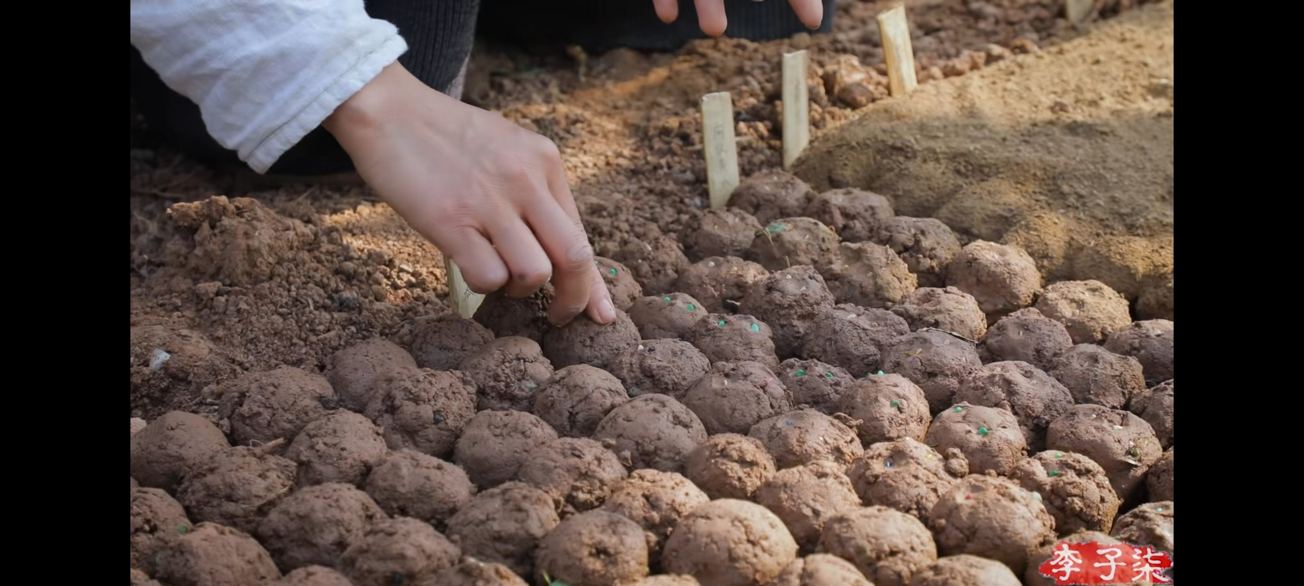
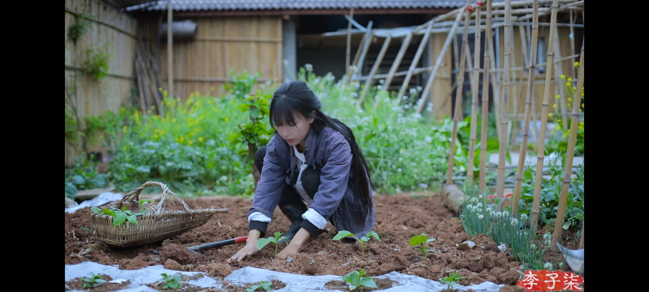
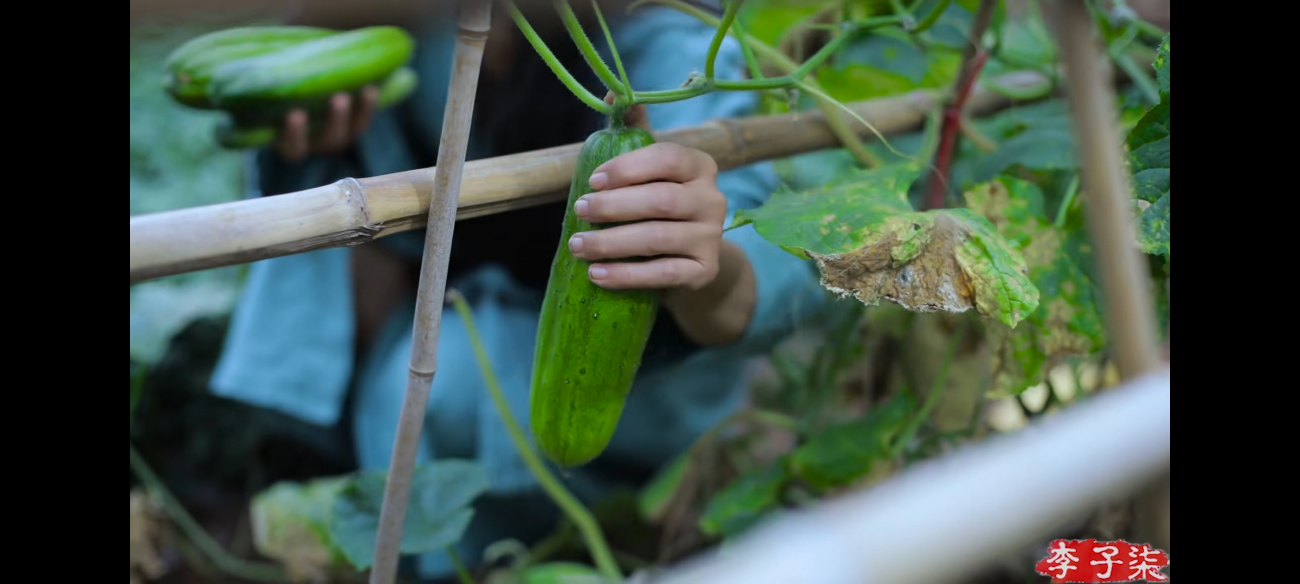
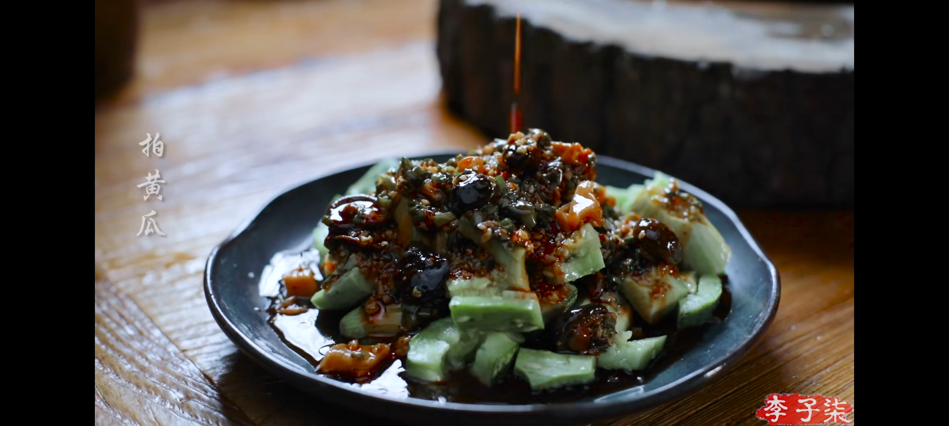
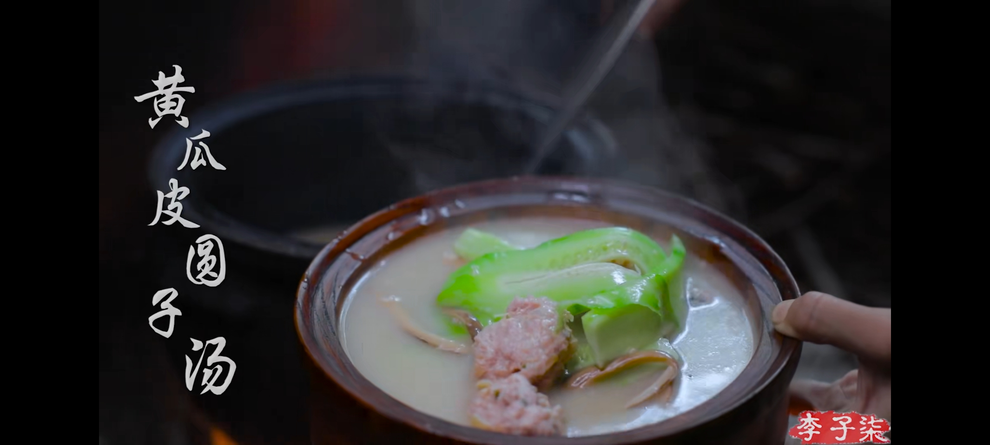
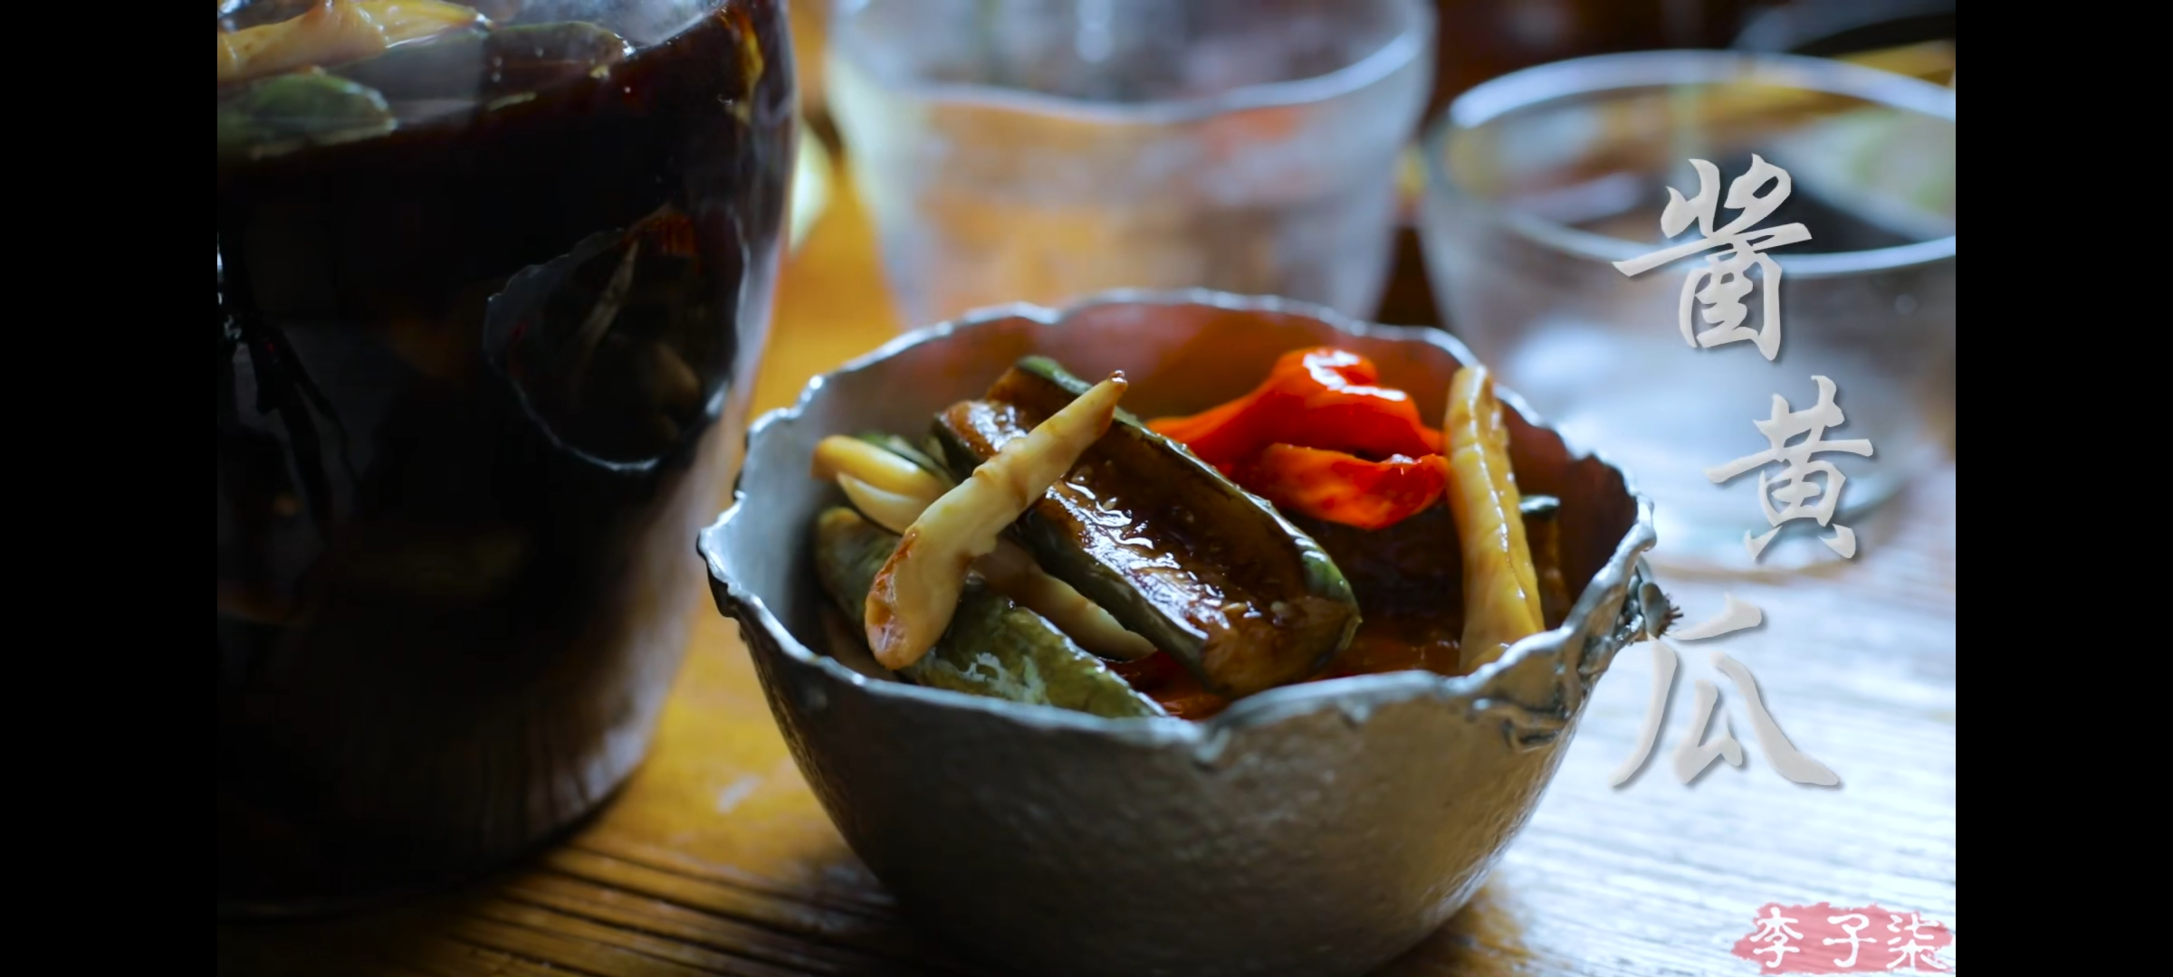
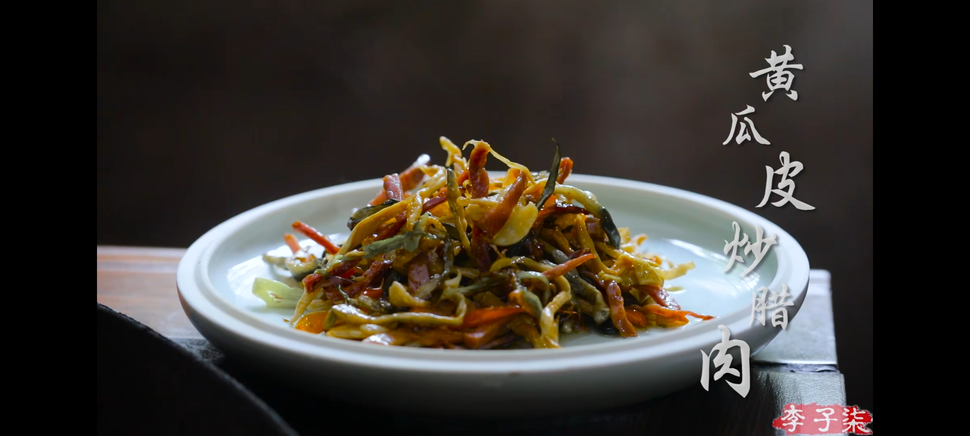
Cucumber's life
Notes:
她的每一个视频都是经过了精心地策划，而且历时长，
Each of her videos is carefully curated and takes a long time,
每一个视频都从食物最开始的状态到最后的状态，如图所示黄瓜的一生，从黄瓜的种植、收获、到由黄瓜制作的美食，每一个步骤都出现在视频中。
Each video is from the beginning of the food to the last state, as shown in the picture, the life of cucumber, from the planting, harvesting, to the gourmet food made from cucumber, each step is presented in the video.

Slide 10
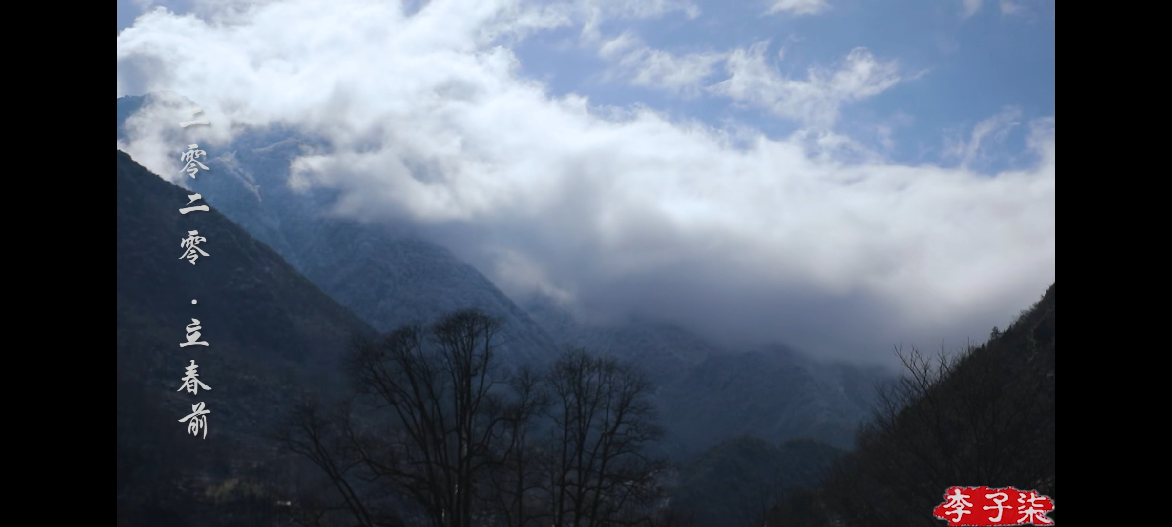
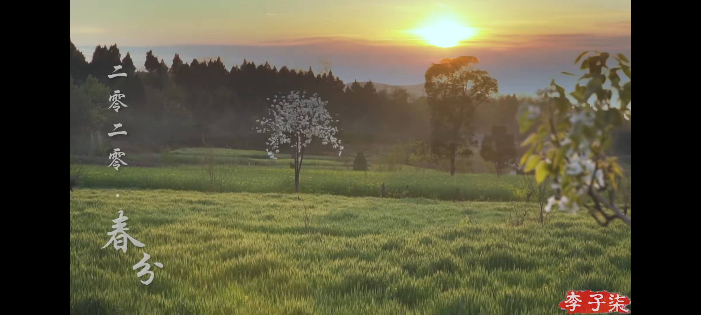
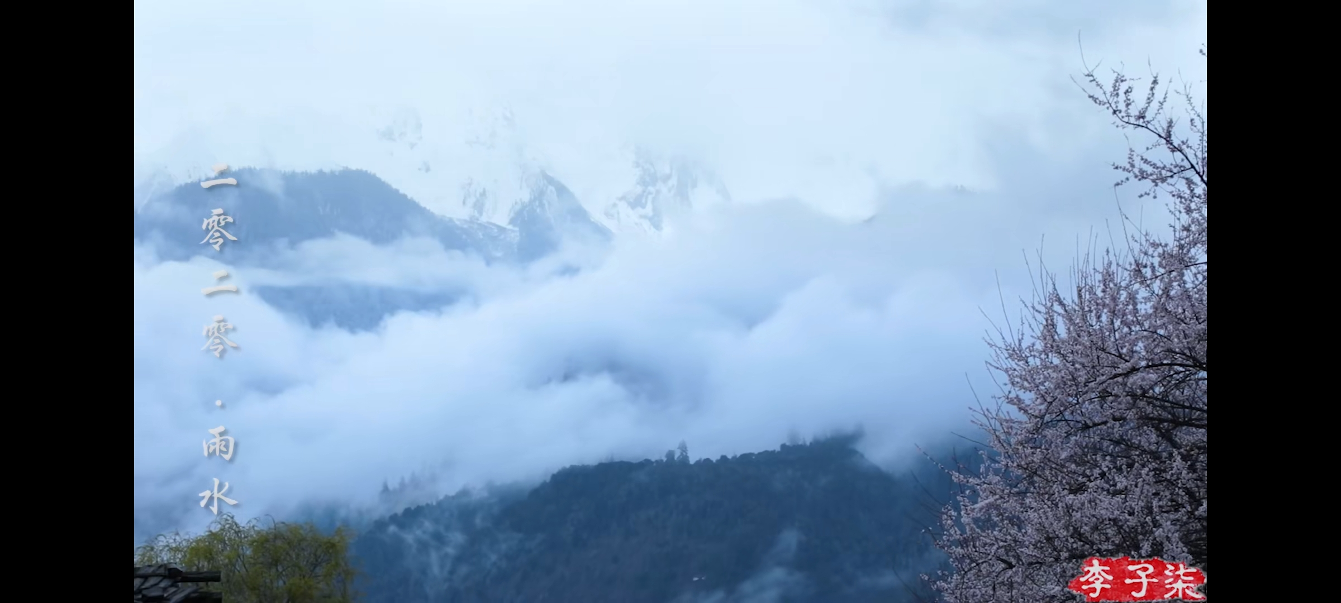
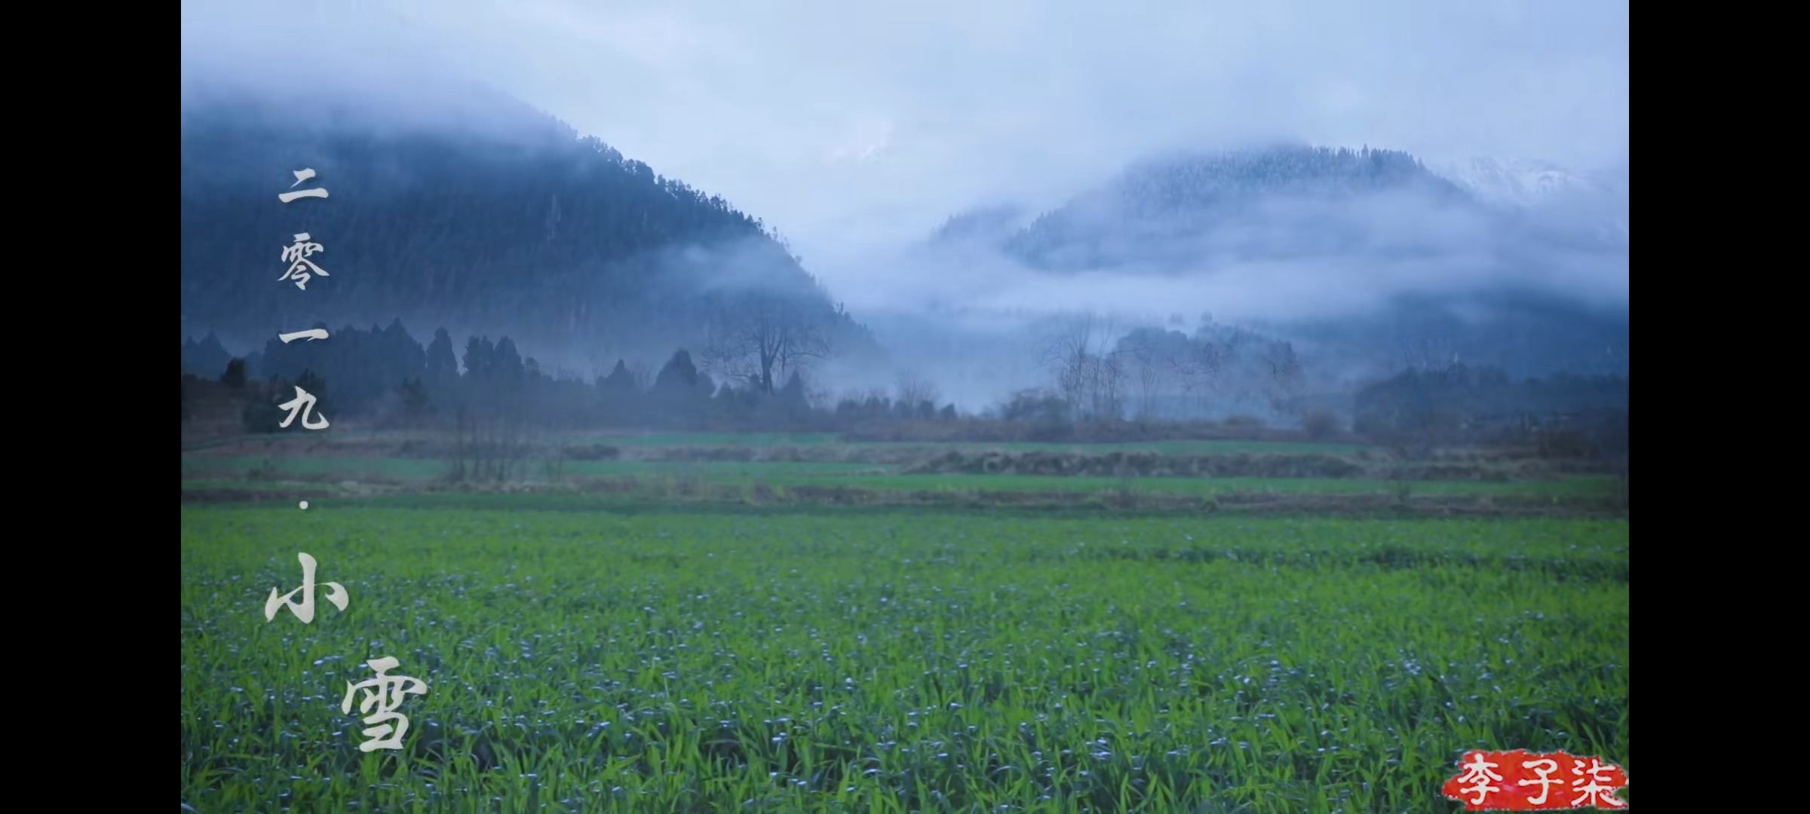
Seasonal solar terms
Spring begins
vernal equinox
The rains
light snow
Notes:
作为一个中国人，她将中华民族传统文化中的时令节气、传统节日、民风民俗等以视频的方式，让更多人了解中国文化，她的视频也展示了很多的中国的传统手艺，也是让更多人喜欢上中国。
As a Chinese, she makes videos of the seasonal solar terms, traditional festivals, folk customs and other aspects of traditional Chinese culture to let more people know about Chinese culture. Her videos also show a lot of traditional Chinese crafts, which also makes more people like China.
图中为几个时令节气
There are several seasonal terms in the picture
时令节气
Seasonal solar terms

Slide 11
PART THREE
Why she became popular?

Slide 12
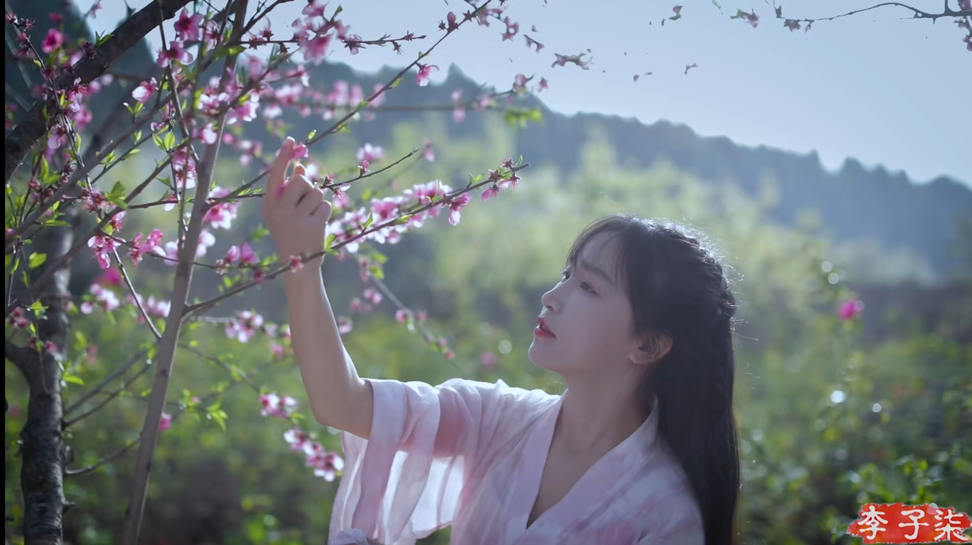
FIRST
She keeps pace with The Times. With the help of the Internet, short video has taken off in recent years. Li Ziqi's popularity is also benefited from the rise of the short video of this wave of dividends.
Notes:
她跟上了时代的步伐。借助互联网，短视频这些年迅速崛起。李子柒的走红，也正是得益于短视频崛起的这波红利。
She keeps pace with The Times. With the help of the Internet, short video has taken off in recent years.
Li Ziqi's popularity is also benefited from the rise of the short video of this wave of dividends.

Slide 13
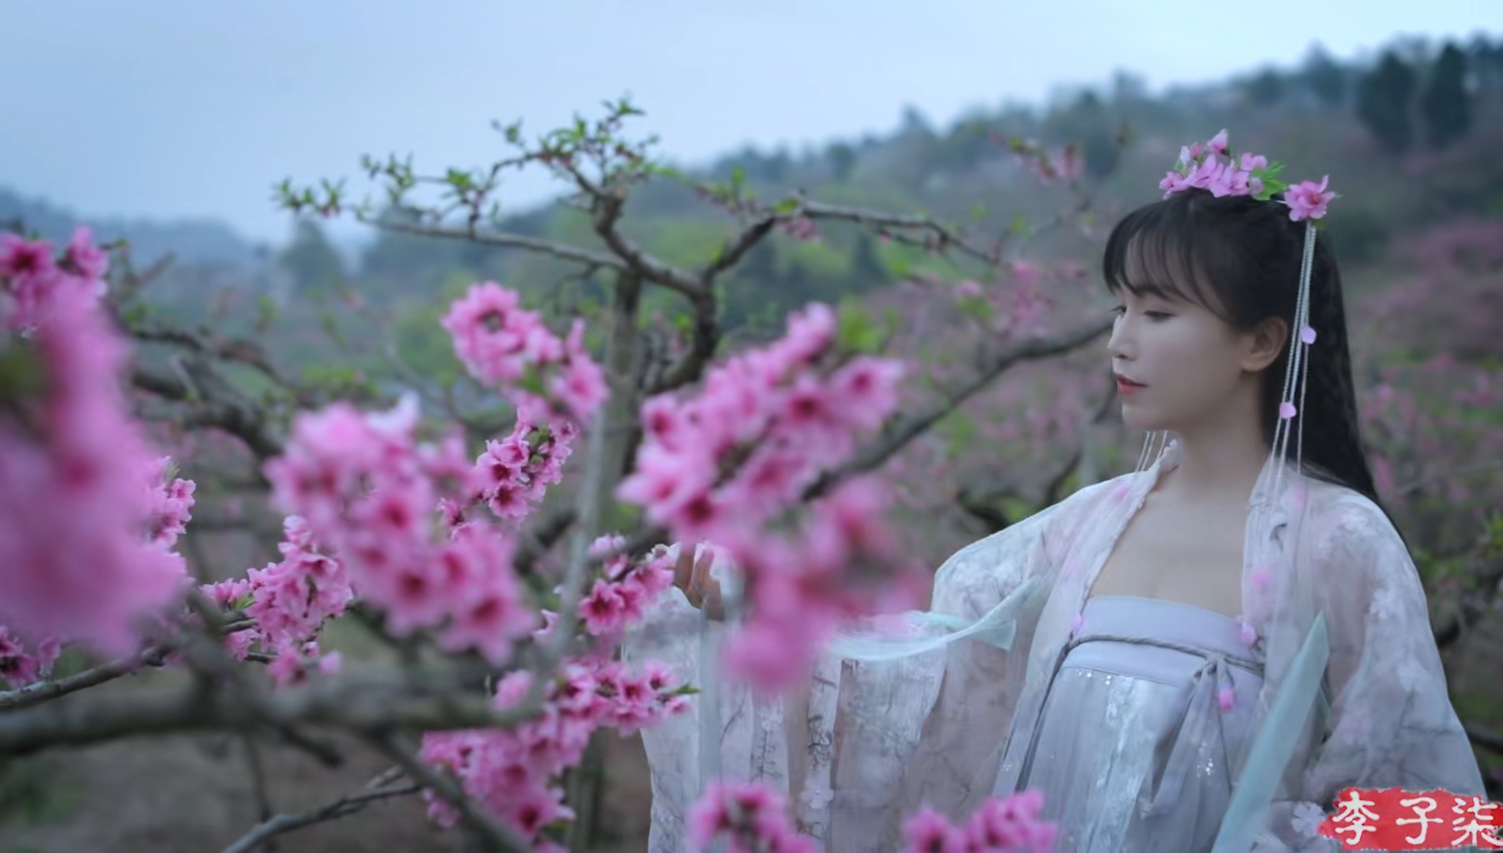
SECOND
More and more people begin to pay attention to China and know more about China. And Li Ziqi is just a window to understand China.
Notes:
越来越多的人开始关注中国，了解中国。而李子柒，正是一个了解中国的窗口。
More and more people begin to pay attention to China and know more about China. And Li Ziqi is just a window to understand China.
她的视频，很少有字幕，没有对白也没有旁白，配着悠扬的音乐，即使是完全不懂汉语的人，也可以全程无障碍地观看。
Her videos have very few subtitles, no dialogue or narration, and melodious music. Even people who don't know Chinese at all can watch them without any problems.

Slide 14
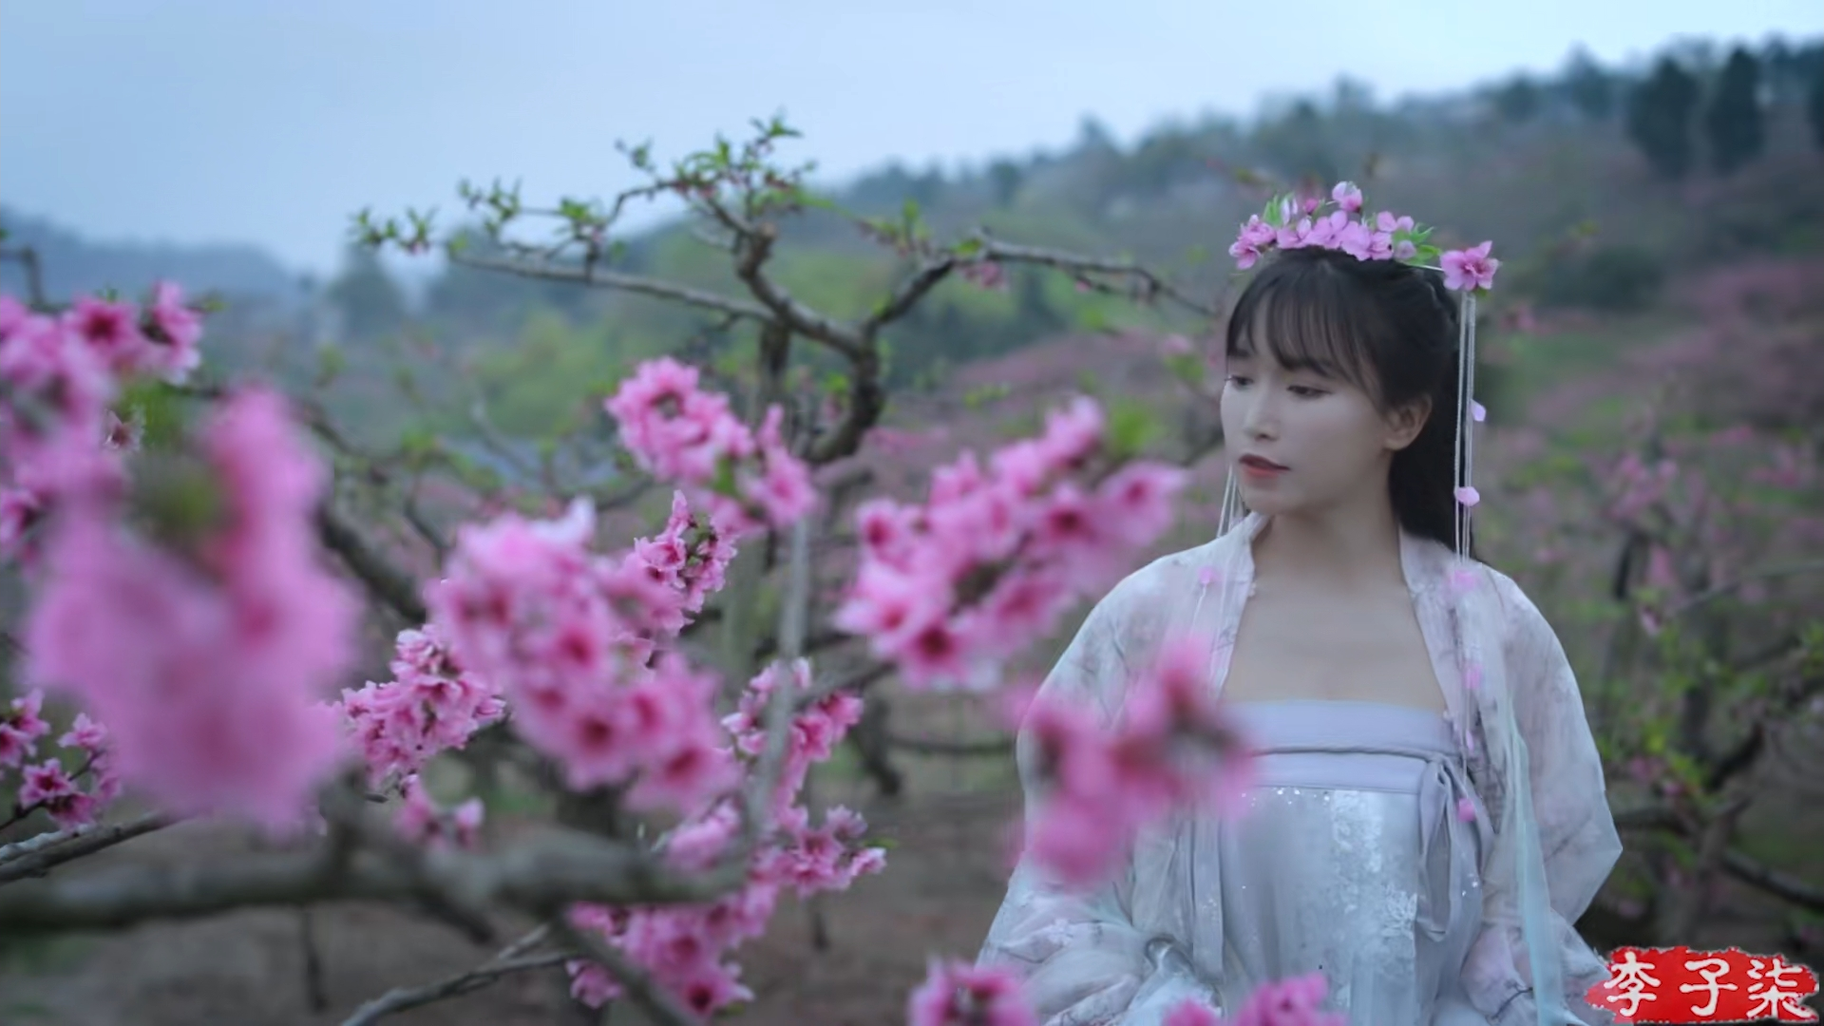
THIRD
She is a positive person who loves life. Her video conveys a refined, civilized, diligent, brave, and true image of China.
At the same time, her video brings positive energy to people.
Notes:
她是一个积极向上的、热爱生活的人。 她的视频传达了精致的，文明的，勤奋的，勇敢的和真实的中国形象。
同时，她的视频给人们带来了积极的能量。
She is a positive person who loves life. Her video conveys a refined, civilized, diligent, brave, and true image of China.
At the same time, her video brings positive energy to people.
她的视频给生活忙碌的人们带来了安心、舒适，并且也能够治愈人们的心灵。
Her video brings peace of mind and comfort to busy people, and can also heal people's hearts.

Slide 15
PART FOUR
Look forward to more people
like Li Ziqi .

Slide 16
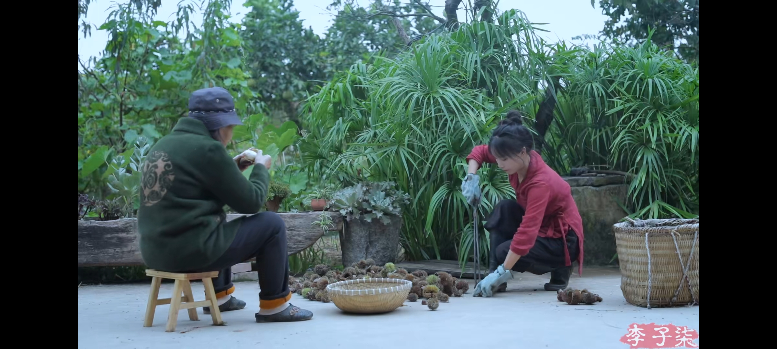
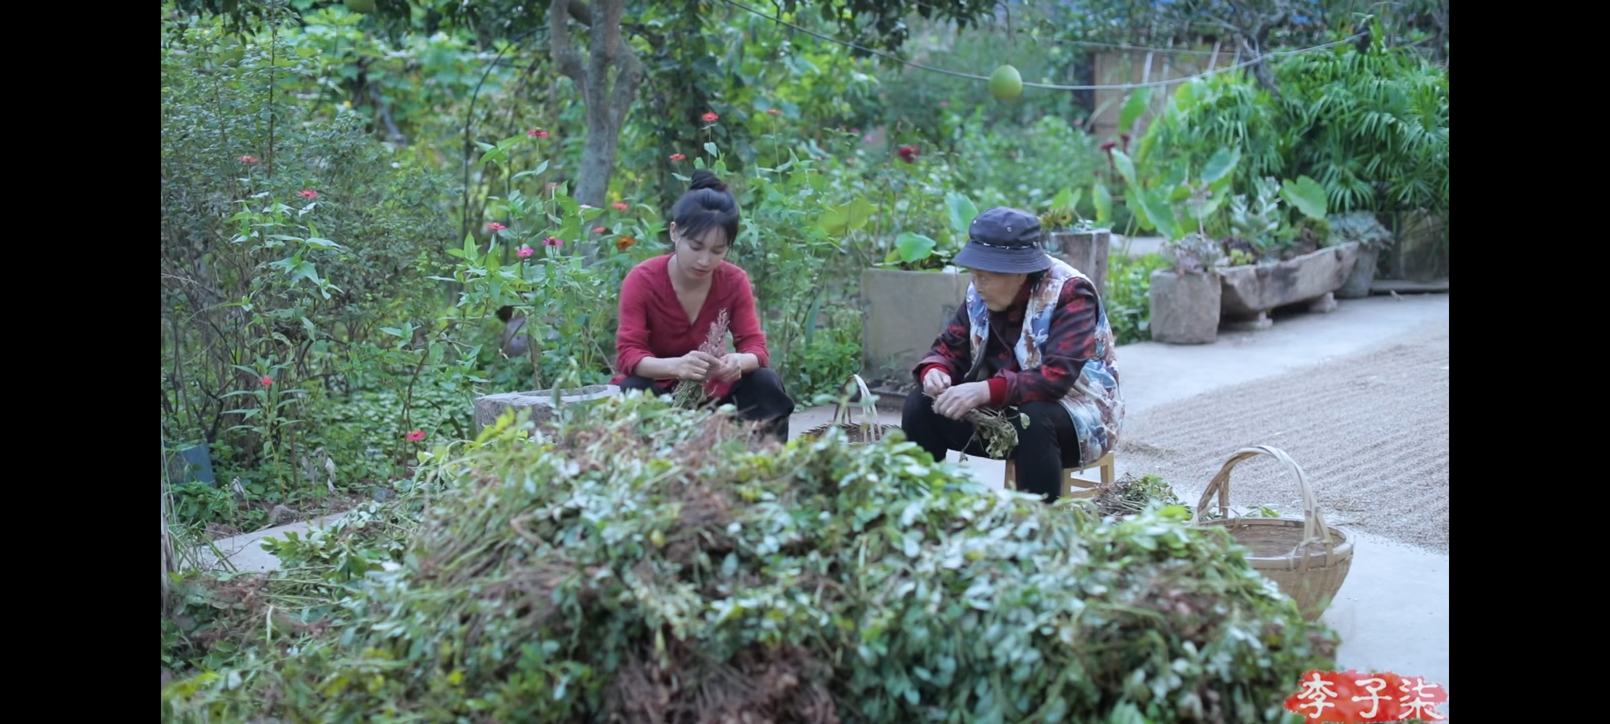
Li Ziqi only recorded the daily life of an ordinary Chinese, but he showed the world a real, rich and beautiful China. She has promoted traditional Chinese culture to the world, allowing more people to understand Chinese culture and love China.
Notes:
李子柒只是记录了一个普通中国人的日常生活，却向世界展现了一个真实的、丰富的、美丽的中国。她向世界弘扬了中国传统文化，让更多的人了解中国文化，喜欢上中国。
Li Ziqi only recorded the daily life of an ordinary Chinese, but he showed the world a real, rich and beautiful China.
She has promoted traditional Chinese culture to the world, allowing more people to understand Chinese culture and love China.
把中华民族的传统的东西展现出来，赋予时代的意义，才是我们应该努力的方向。因此期待更多的李子柒。
It is the direction we should strive to show the traditional things of the Chinese nation and give the meaning of the times. So look forward to more people like Li Ziqi.

Slide 17
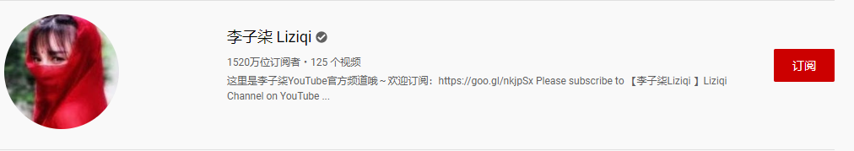
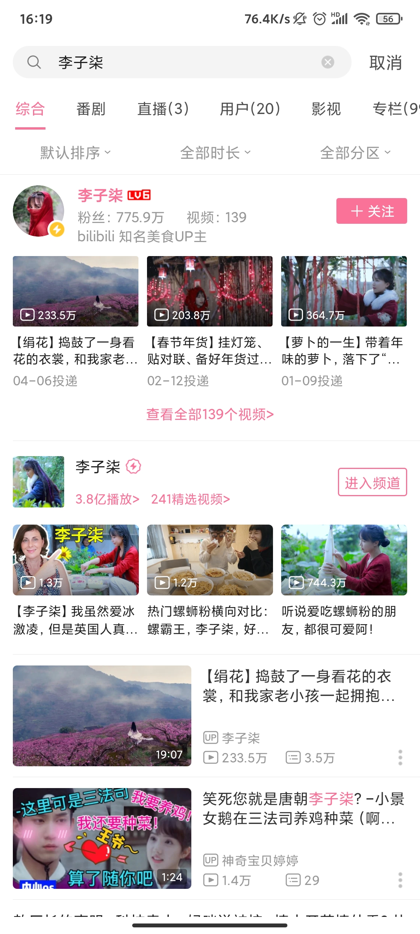
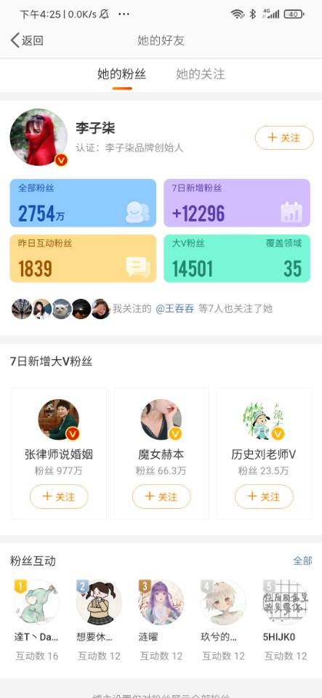
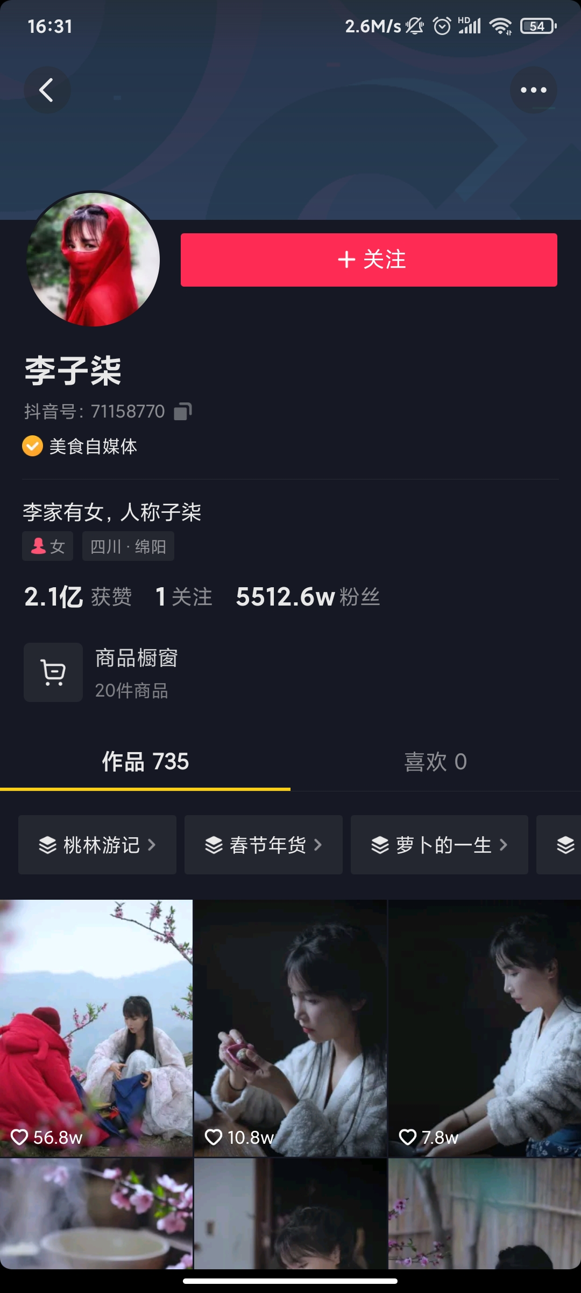
Subscribe to her
赶紧去订阅她吧！！！
Notes:
上面是关于李子柒的一些官方账号。
The above are some official accounts about Li Ziqi.
如果你想要更多的了解她或者观看她更多的发布的视频，你可以订阅她在bilibili、微博、youtube上的官方账号，希望你也可以喜欢她的视频，并且也期待你能成为下一个李子柒。
If you want to know more about her or watch her more published videos, you can subscribe to her official accounts such as bilibili, Weibo, youtube, etc. I hope you can also like her videos and look forward to your becoming the next A Li Ziqi.

Slide 18

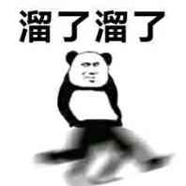
Thank you for your watching

